Slide 1
Serotonin Syndrome (Toxicity)
STUDENT’S NAME
INSTITUTION OF AFFILIATION
COURSE CODE AND NAME
PROFESSOR
DATE

Slide 2
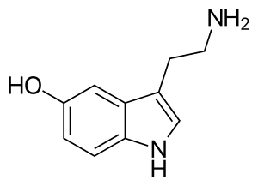
Definition of Terms
Serotonin (5-HT) – Neurotransmitter
Produced by/in:
Brain/CNS
Intestines
Platelets
Functions:
Both at the level of the brain and the body
Influences a wide range of psychological and bodily functions
Regulates moods, social behavior, sexual desire, sleep, and appetite (Truschel, 2020).

Slide 3
Definition of Terms
Serotonin Syndrome (SS)
Also - serotonin toxicity
It refers to a group of symptoms that may occur with the use of certain serotonergic medications or drugs (Ferri, 2016)
It occurs following increase in concentration of the neurotransmitter – serotonin
It is potentially a life- threatening condition resulting from having too much serotonin in the body (Truschel, 2020)

Slide 4
SS - Causes
The use of certain serotonergic medications or drugs
Examples
1) Commonly used antidepressants such as the:
Selective Serotonin Reuptake Inhibitors (SSRI)
Serotonin Norepinephrine Reuptake Inhibitor (SNRI)
Monoamine Oxidase Inhibitors (MAOIs)
Tricyclic antidepressants (TCAs)
2) Opioids – e.g.
Dextropropoxyphene, tramadol, tapentadol, pethidine (meperidine), fentanyl, pentazocine, oxycodone, hydrocodone
3) CNS Stimulants – e.g.
MDMA, MDA, amphetamine, methamphetamine, serotonin releasing agents like hallucinogenic substituted amphetamines
4) Serotonin receptor 1 (5-HT 1) agonist – Triptans
5) Psychedelics – e.g. 5-methoxy-diisopropyltryptamine
6) Herbs such as St John’s Wort
7) Others – Tryptophan, L-Dopa, valproate, buspirone, lithium etc.

Slide 5
Epidemiology
Occurs in about 15% of SSRI overdoses (Domino & Baldor, 2014).
In 2004 – 8,187 cases of serotonin toxicity among patients taking /due to SSRIs
Of these cases, 103 deaths occurred (Truschel, 2020)
Actual figures could be way higher today since those that suffer from mild to moderate serotonin toxicity go undiagnosed or unreported (Truschel, 2020).

Slide 6
SS - Pathophysiology
Serotonin is a neurotransmitter involved in multiple complex biological processes
These include: aggression, pain, sleep, appetite, depression, migraine, and vomiting
1960 - Effects of excess serotonin were first noticed in a patient receiving a monoamine oxidase inhibitor (MAOI) and tryptophan (Oates & Sjoerdsma, 1960)
Cause – excess serotonin in the Central Nervous System (CNS)
Mechanism – through agonistic effects of serotonin on its receptor subtypes resulting in their overstimulation

Slide 7
SS – Pathophysiology cont’d
Implicated receptor subtypes:
Previously - 5-HT1A receptors in the central grey nuclei and the medulla
Currently - overstimulation of primarily 5-HT2A receptors
5-HT1A receptors still play a role in the development of the syndrome through a pharmacodynamics interaction in which increased synaptic concentrations of a serotonin agonist saturate all receptor subtypes (Boyer & Shannon, 2005)

Slide 8
SS – Pathophysiology cont’d
Other neurotransmitters systems implicated:
Noradrenergic CNS hyperactivity – CNS norepinephrine concentrations are increased in SS, and the levels appear to correlate with the clinical outcome.
NMDA receptor antagonists and GABA – suggested as affecting the development of the syndrome (Boyer & Shannon, 2005)

Slide 9
SS - Risk Factors
If recently taking or increased the dose of a medication known to increase serotonin levels,
If taking more than one drug known to increase serotonin levels,
Consumption of herbal supplements known to increase serotonin levels, and
Use of an illicit drug known to increase serotonin levels (Mayo Clinic, 2020)
NB: SS is more pronounced following supra-therapeutic doses and overdoses; they merge in a continuum with the toxic effects of overdoses (Isbister et al., 2004)

Slide 10
Signs and Symptoms
Vary from mild to severe
Mild Symptoms
Moderate Symptoms
Mydriasis (dilated pupils)
Shivering
Sweating
Mild tachycardia
Management:
Observe for at least 6Hours
Give - Benzodiazepines
Divided into 3 categories
Altered Mental Status
Autonomic Hyperactivity
Neuromuscular abnormalities
Management:
Admit to hospital
Cardiac monitoring
Give - Cyproheptadine

Slide 11
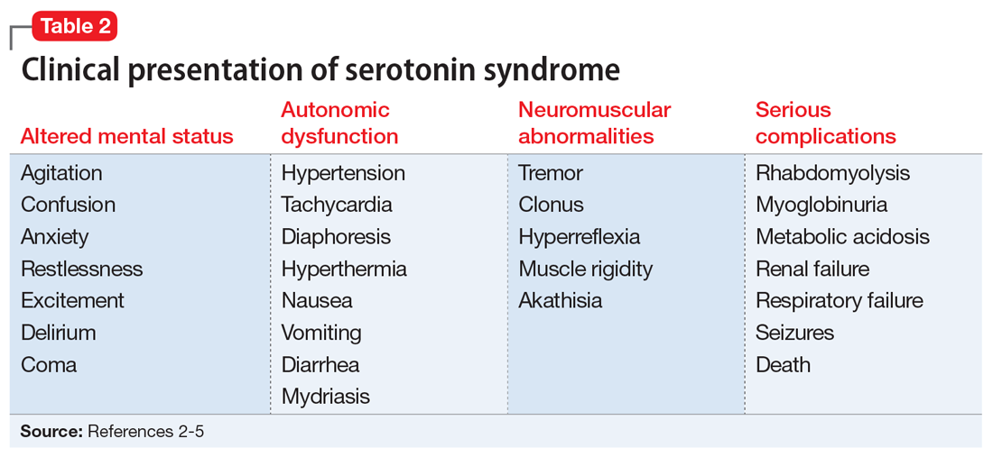
Moderate Symptoms
Notes:
Courtesy of Tulane University: School of Medicine. Retrieved from http://tmedweb.tulane.edu/pharmwiki/doku.php/serotonin_syndrome

Slide 12
SS- Severe/Life- threatening symptoms
Delirium
Hypertension
Hyperthermia
Muscle rigidity
Tachycardia
Management:
Transfer to the Intensive Care Unit (ICU)
Give – Esmolol or nitroprusside
Ake cooling measures:
Sedation, SkM paralysis, ventilation

Slide 13
Severe Complications
Consequences of long-standing, untreated condition.
Includes:
Rhabdomyolysis
Myoglobinuria
Metabolic Acidosis
Renal failure
Respiratory failure
Seizures
Death

Slide 14
Diagnosis
No specific test
Diagnosis is by symptom observation and investigation of the patient’s history (Boyer & Shannon, 2005)
Several criteria for diagnosis have been proposed, e.g.
1991 by Henry Sternbach – most commonly used
Hunter Toxicity Criteria Decision Rules with better sensitivity (84%) and specificity (97%)
The most important symptoms for diagnosis are: tremor, extreme aggressiveness, akathisia, or clonus (Spontaneous, inducible and ocular) (Dunkley et al., 2003)

Slide 15
References
Boyer, E. W. & Shannon, M. (2005). The Serotonin Syndrome. The New England Journal of Medicine, 352(11): 1112-1120
Domino, F. & Baldor, R. (2014). The 5-Minute Clinical Consult 2014. Lippincott Williams & Wilkins. pp. 1124
Dunkley, E., Isbister, G., Sibbritt, D., Dawson, A., & Whyte, M. (2003). The Hunter Serotonin Toxicity Criteria: Simple and Accurate Diagnostic Decision Rules for Serotonin Toxicity. QJM, 96(9): 635-42
Ferri, F. (2016). Ferri’s Clinical Advisor 2017: 5 Books in 1. Elsevier Health Sciences. pp. 1154-1155
Isbister, G., Bowe, S., Dawson, A., & Whyte, I. (2004). Relative toxicity of selective serotonin reuptake inhibitors (SSRIs) in overdose. J Toxicol Clin Toxicol., 42(3): 277-85
Mayo Clinic (2020). Serotonin Syndrome. Retrieved from https://www.mayoclinic.org/diseases-conditions/serotonin-syndrome/symptoms-causes/syc-20354758
Oates, J. & Sjoerdsma, A. (1960). Neurologic effects of tryptophan in patients receiving a monoamine oxidase inhibitor. Neurology, 10(12): 1076-8
Truschel, J. (2020). Serotonin Syndrome (Toxicity): Symptoms, Causes & Treatment. Retrieved from https://www.psycom.net/serotonin-syndrome/

